Slide 1

N e x t H I k e s I T S o l u t I o n
Title:- Exploratory Data Analysis (EDA) for Real Estate Pricing
Unveiling the Dynamics of House Valuation in a Dynamic Market
Name:- Ashish Pachauri

Slide 2

Introduction of EDA(Exploratory Data Analysis)
Exploratory Data Analysis is a process of examining or understanding the data and extracting insights dataset to identify patterns or main characteristics of the data. EDA is generally classified into two methods, i.e. graphical analysis and non-graphical analysis.
In this presentation, we will explore Exploratory Data Analysis (EDA) and Feature Engineering. These techniques are essential for extracting meaningful insights from data. We will cover methodologies, best practices, and practical applications to enhance your data analysis skills.
Importance of EDA
EDA is important because it provides a visual summary of the data, revealing insights that might not be apparent through raw data analysis. It aids in understanding the distribution, relationships, and potential data quality issues that need addressing.

Slide 3
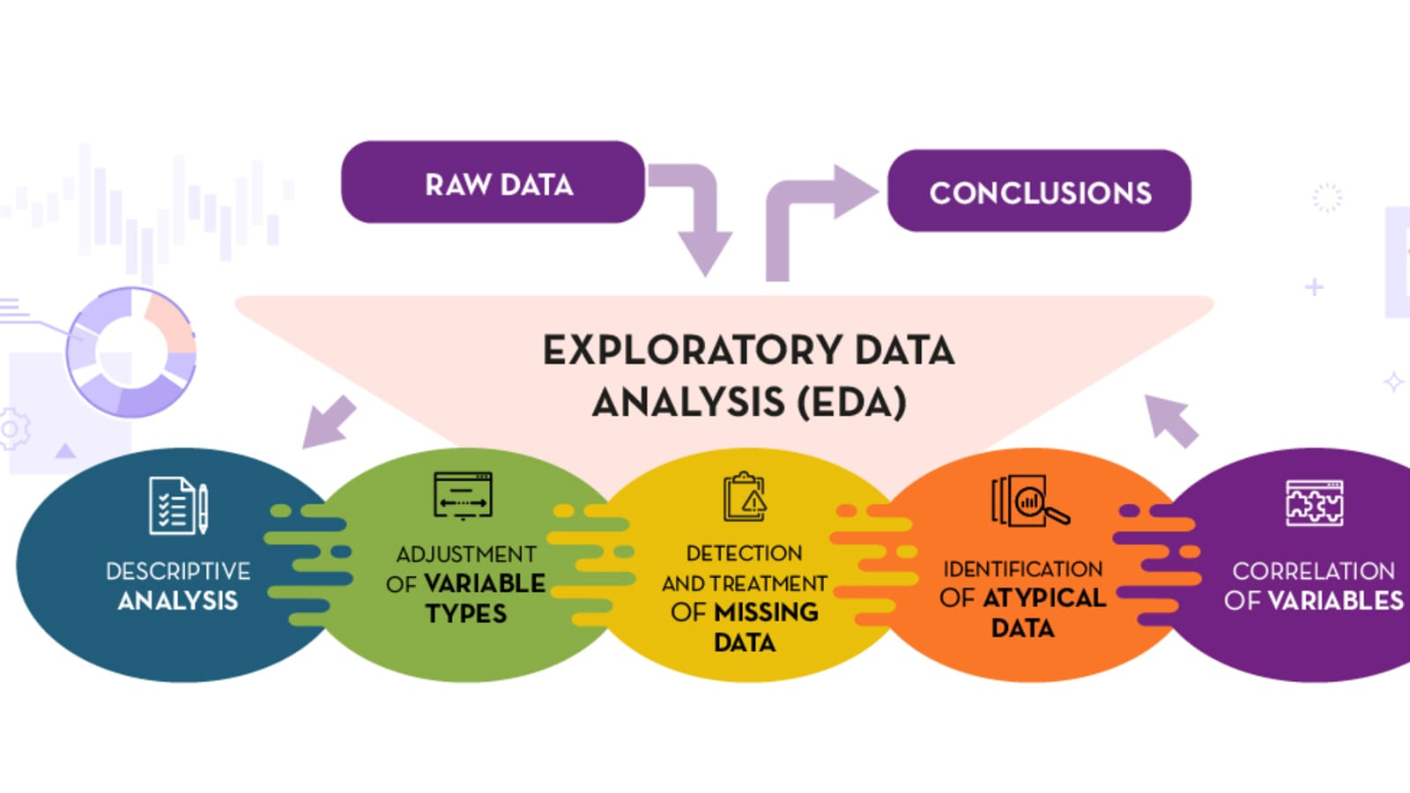
Topics Covered:-
Common EDA Techniques
.EDA(Exploratory Data Analysis)
Data Visualization
Practical Insights & Market Trends
Features Engineering
Univariate Analysis
Bivariate Analysis
Multivariate Analysis
Some common EDA techniques include summary statistics, visualization, and data cleaning. Techniques like histograms, scatter plots, and correlation matrices help in understanding data distributions and relationships, which are crucial for informed decision-making.

Slide 4
Key reasons why EDA is important:
Data Quality Check:
EDA helps detect anomalies, missing values, and inconsistencies in the data, allowing for necessary cleaning and pre-processing steps to improve data quality.
Pattern Recognition:
By visualizing and summarizing data, EDA helps identify trends, relationships, and patterns between variables, which can guide further analysis and hypothesis generation.
Outlier Detection:
EDA allows for the identification of outliers, data points that significantly deviate from the rest of the data, which can be crucial for understanding potential anomalies and adjusting modeling strategies.
Feature Understanding:
EDA helps to understand the characteristics of each variable within the dataset, including their distribution, range, and potential relationships with other variables.

Slide 5
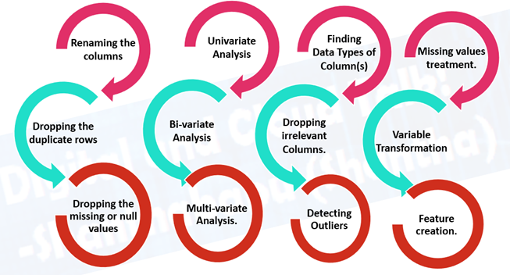
Model Improvement:
Insights gained from EDA can guide feature engineering and model selection, leading to improved model performance.
Univariate Analysis
Bivariate Analysis
Multivariate Analysis
Types of EDA
Phase 1 - Data Acquisition
Description:
Loading data into Python using Pandas.
Example code.
python
df1 = pd.read_csv(df1 = pd.read_csv(r"C:\Users\Dell\Desktop\housing_data.csv")

Slide 6

Tools and Technologies
Python Libraries
1.Pandas
2.NumPy
3.Matplotlib
4.Seaborn
5.Scipy
Using jupyter notebook

Slide 7
Data Overview
Dataset Summary:
Total Rows: 1460
Key columns include:
80
Data Structure
Unnamed | MSSubClass | MSZoning | LotFrontage | LotArea | YrSold | SaleCondition | PoolArea | MoSold | SalePrice
0 | SC60 | RL | 65 | 8450 | 2008 | Normal | 0 | Feb | 208500
Data types-:
1.Integers
2. Float
3.Datetimes
4.Object

Slide 8
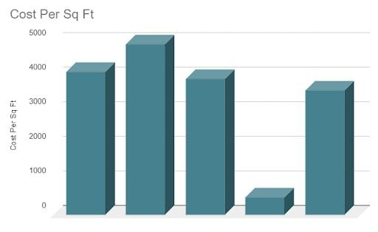
Feature Engineering
What Is Feature Engineering?
Feature engineering is a machine learning technique that leverages data to create new variables that aren’t in the training set. It can produce new features for both supervised and unsupervised learning, with the goal of simplifying and speeding up data transformations while also enhancing model accuracy. Feature engineering is required when working with machine learning models. Regardless of the data or architecture, a terrible feature will have a direct impact on your model.
Feature engineering is the process of selecting, manipulating and transforming raw data into features that can be used in supervised learning. It consists of five processes: feature creation, transformations, feature extraction, exploratory data analysis and benchmarking.

Slide 9
Feature Engineering Processes
Feature creation: Creating features involves creating new variables which will be most helpful for our model. This can be adding or removing some features. As we saw above, the price per sqft column was a feature creation.
Transformations: Feature transformation is simply a function that transforms features from one representation to another. The goal here is to plot and visualize data. If something isn’t adding up with the new features, we can reduce the number of features used, speed up training or increase the accuracy of a certain model.
Feature extraction: Feature extraction is the process of extracting features from a data set to identify useful information. Without distorting the original relationships or significant information, this compresses the amount of data into manageable quantities for algorithms to process.
Exploratory data analysis : Exploratory data analysis is a powerful and simple tool that can be used to improve your understanding of your data, by exploring its properties. The technique is often applied when the goal is to create new hypotheses or find patterns in the data. It’s often used on large amounts of qualitative or quantitative data that haven’t been analyzed before.

Slide 10
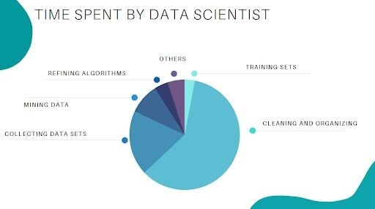
Importance of Feature Engineering
Feature engineering is a very important step in machine learning. Feature engineering refers to the process of designing artificial features into an algorithm. These artificial features are then used by that algorithm in order to improve its performance, or in other words, reap better results. Data scientists spend most of their time with data, and it becomes important to make models accurate.
When feature engineering activities are done correctly, the resulting data set is optimal and contains all of the important factors that affect the business problem. As a result of these data sets, the most accurate predictive models and the most useful insights are produced.

Slide 11
Feature Engineering Techniques
1.Imputation
Missing values are one of the most common issues you’ll come across when it comes to preparing your data for machine learning.data flow interruptions, privacy concerns and other factors could all contribute to missing values. Missing values have an impact on the performance of machine learning models. The main goal of imputation is to handle these missing values. There are two types of imputation
Numerical imputation.
Categorical imputation.
2. Handling Outliers
Outlier handling is a technique for removing outliers from a data set. This method can be used on a variety of scales to produce a more accurate data representation. This has an impact on the model’s performance.
3. Log Transform
Log transform is the most used technique among data scientists. It’s mostly used to turn a skewed distribution into a normal or less-skewed distribution.
4. One-Hot Encoding
A one-hot encoding is a type of encoding in which an element of a finite set is represented by the index in that set, where only one element has its index set to “1” and all other elements are assigned indices within the range[0, n-1]. In contrast to binary encoding schemes, where each bit can represent two values (i.e. 0 and 1), this scheme assigns a unique value for each possible case.

Slide 12
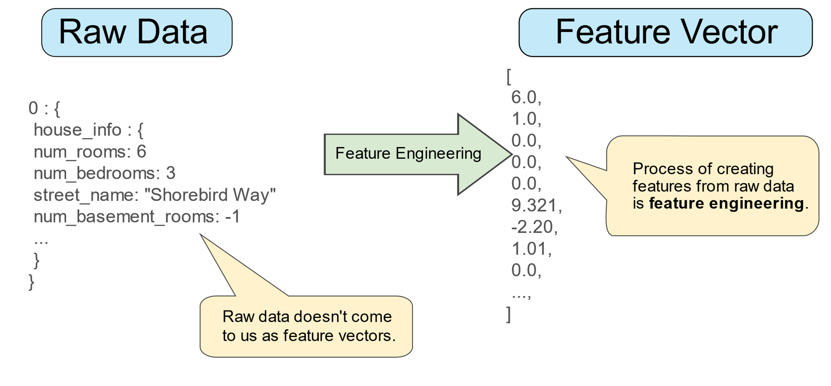
5. Scaling
Feature scaling is one of the most pervasive and difficult problems in machine learning, yet it’s one of the most important things to get right. In order to train a predictive model, we need data with a known set of features that needs to be scaled up or down as appropriate. After a scaling operation, the continuous features become similar in terms of range. Although this step isn’t required for many algorithms, it’s still a good idea to do so. Distance-based algorithms like k-nearest neighbor and k-means, on the other hand, require scaled continuous features as model input. There are two common ways for scaling

Slide 13
Data Cleaning & Feature Engineering
Dropped Columns: Alley, Utilities, PoolQC, and others due to high null values or redundancy.
New Features Created: PricePerSqFt, HouseAge, TotalSF, TotalBath
MoYrSold created by merging MoSold and YrSold.
Data Type Adjustments: SalePrice converted to float, GarageYrBlt to int.
Handling Missing Values:
Median imputation for numerical columns.
Mode imputation for categorical columns.

Slide 14
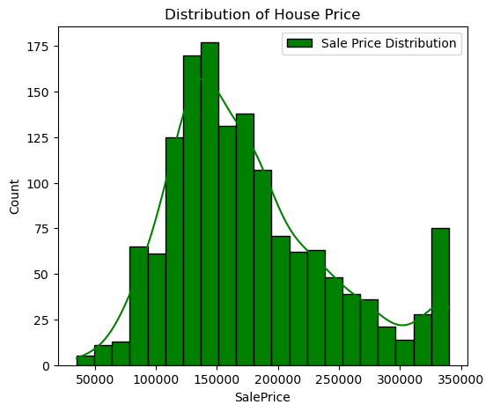
Visualization and Insights
Univariate Analysis:-
Univariate analysis is a statistical technique that analyzes one variable in a data set. It's the most basic way to analyze data.
Sale Price Distribution
Using Histplot
Insight
1.Most Common House Prices: The majority of house prices are between 100,000 and 200,000, with the highest concentration around 150,000.
2.Peak in Distribution: There is a noticeable peak around 150,000, indicating that this price range is the most common.
3.Right-Skewed Distribution: The distribution is right-skewed, meaning there are fewer houses priced above 200,000.
4.High-Priced Houses: There is a small secondary peak around 350,000, indicating that there are some high-priced houses as well.

Slide 15
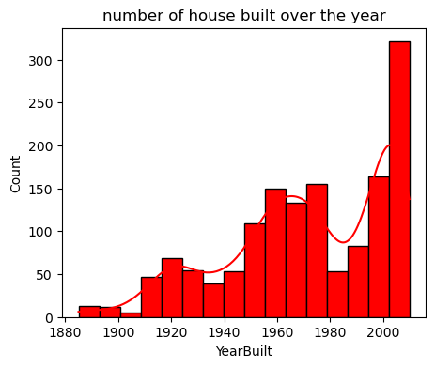
number of house built over the year
Using Histplot
Insight
Significant Peak Around 2000: The graph shows a notable peak around the year 2000, where the number of houses built exceeds 300. This suggests a construction boom or high demand for housing during that period.
Early Years (1880-1950): The number of houses built in the early years is relatively low, indicating less construction activity during that time. This could be due to factors like lower population, limited construction technology, or different housing needs.
Steady Growth Post-1950: After 1950, there is a steady increase in the number of houses built, reflecting economic development, urbanization, and increased demand for housing.
6.Fluctuations: While the overall trend is upward, there are periods of fluctuation, indicating that construction activity was not consistent every year.

Slide 16
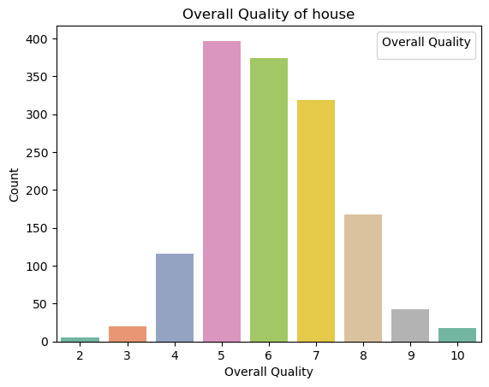
Overall Quality of house
Using Countplot
Insight
Moderate Ratings: Ratings of 7 are also relatively common, with a count of around 300. This indicates a significant number of properties have above-average quality.
Low Ratings: Ratings of 4 and 8 have moderate counts, around 50 and 175, respectively. This shows fewer properties with below-average or good quality.
Rare Ratings: Ratings of 9 and 10 are less common, with counts around 50 and 25, respectively. This indicates that properties with excellent quality are rare.
Average Quality Properties: Given that the most frequent ratings are 5 and 6, we can infer that the majority of the properties fall within an average quality range. This might reflect the standard quality expectations for houses in this dataset.

Slide 17
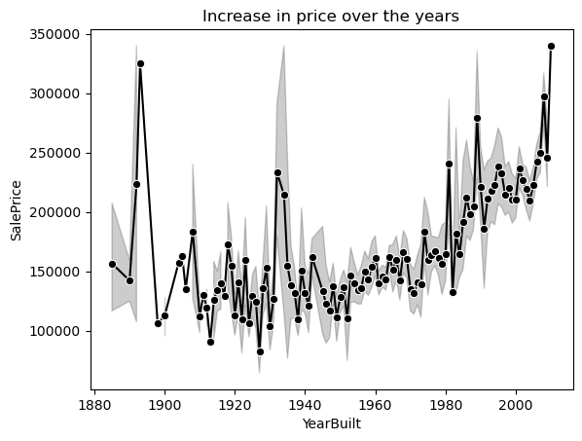
Bivariate analysis
Bivariate analysis is one of the simplest forms of quantitative analysis. It involves the analysis of two variables, for the purpose of determining the empirical relationship between them. Bivariate analysis can be helpful in testing simple hypotheses
price over the years
Using Lineplot
Insight
Early Years Fluctuation: The early years (1880-1920) show a lot of fluctuation in prices, with some peaks and troughs.
Stable Period: The period from 1920 to 1980 shows relatively stable prices with some fluctuations but no clear upward or downward trend.
There is a noticeable increase in sale prices starting from around 1980, with a more pronounced upward trend continuing into the 2000s.
During 2000,the highest sale prices were observed, indicating a strong upward trend.

Slide 18
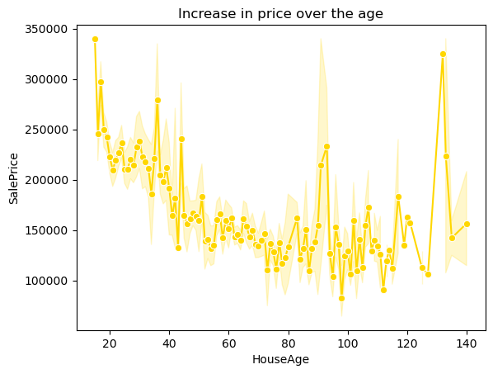
price over the age
Using LinePlot
Insight
Around the 60-year mark, the line starts to level off, indicating that the sale prices tend to stabilize for houses older than 60 years. This suggests a consistent market value for very old houses.
I noticed significant upward spikes at certain ages, such as around 20, 80, and 140 years. These spikes stand out from the general downward trend and indicate higher sale prices for houses at these specific ages.
The stabilization of prices after around 60 years indicates that older homes might have a stable market value. This stability could be attractive for long-term investors or buyers looking for properties with consistent value.

Slide 19
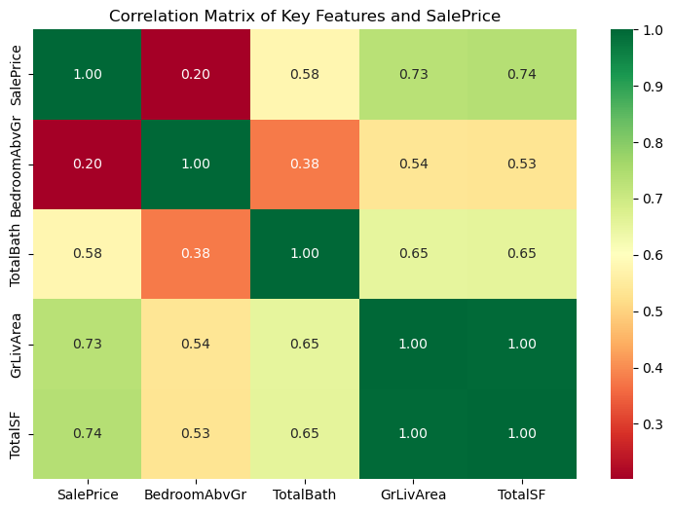
Correlation Matrix of SalePrice
Key features = ['SalePrice', 'BedroomAbvGr', 'TotalBath', 'GrLivArea', 'TotalSF']
Insights of Heatmap
TotalBath and Other Features: TotalBath has a moderate positive correlation with both GrLivArea (0.65) and TotalSF (0.65), suggesting that properties with more bathrooms tend to have larger living areas and total square footage.
SalePrice and BedroomAbvGr: The correlation between SalePrice and BedroomAbvGr is relatively weak (0.20), suggesting that the number of bedrooms above ground has a minimal impact on sale price.
SalePrice and TotalSF: There is a strong positive correlation (0.74) between SalePrice and TotalSF, indicating that houses with larger total square footage tend to have higher sale prices.

Slide 20
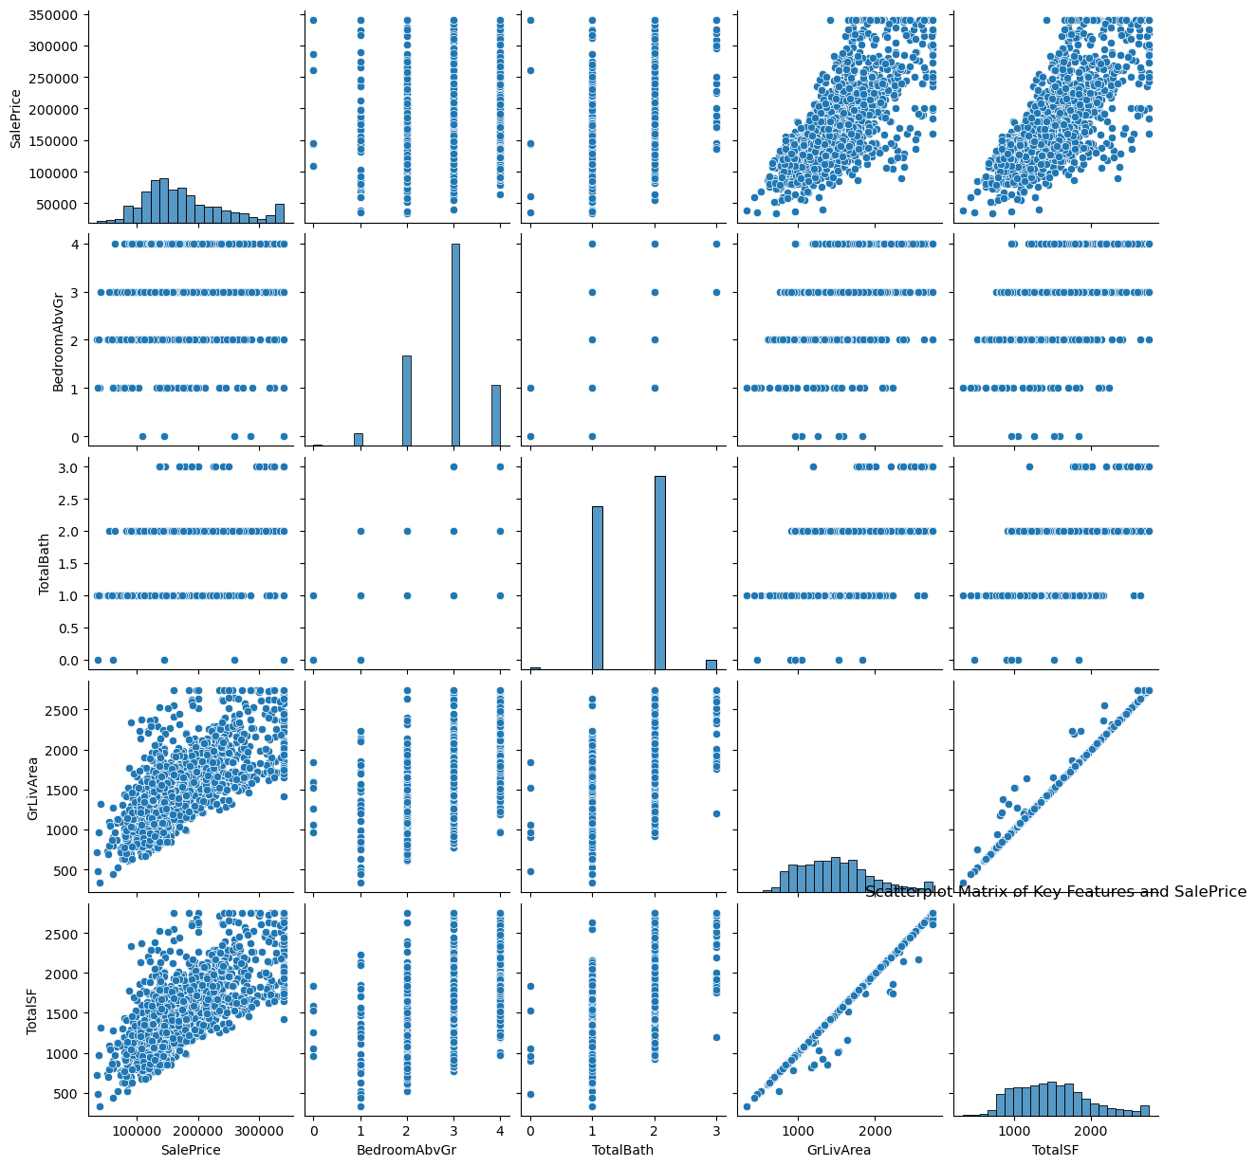
Insights of Pairplot
GrLivArea vs. TotalSF: There is a strong positive correlation between GrLivArea and TotalSF, which is expected as both metrics measure the size of the home.
Distributions of Variables: The histograms on the diagonal show the distribution of each variable:
SalePrice: Right-skewed distribution, indicating that most homes are priced lower with a few high-priced outliers.
GrLivArea and TotalSF: Both have right-skewed distributions, meaning there are more smaller homes with fewer large ones.
BedroomAbvGr and TotalBath: More discrete distributions with fewer unique values.

Slide 21
Conclusions
Strong Influencers of Sale Price:
Above-ground living area (GrLivArea) and Basement size (TotalBsmtSF) are primary drivers of higher sale prices.
Garage capacity also influences price, though less strongly.
Feature Engineering Impact:
Creating new metrics like PricePerSqFt and HouseAge can enhance predictive models.
Larger living spaces (GrLivArea) have the strongest positive impact on house prices.
Basement area (TotalBsmtSF) also significantly influences the sale price.
Houses with more garage spaces tend to sell at higher prices, though this relationship is weaker compared to living space size.
Properties built after 2000 showed a consistent increase in price per square foot

Slide 22
References
Websites and Online Resources:
KDnuggets (www.kdnuggets.com):
A website that provides articles, tutorials, and resources on data science and analytics.
Tableau Blog (www.tableau.com/blog):
Offers insights and case studies on data visualization.
www.geeksforgeeks.org
https://builtin.com/articles/feature-engineering

Slide 23
Thank you

